Slide 1

GitHub & Project Sharing
BAIS:3250 – Data Wrangling

Slide 2
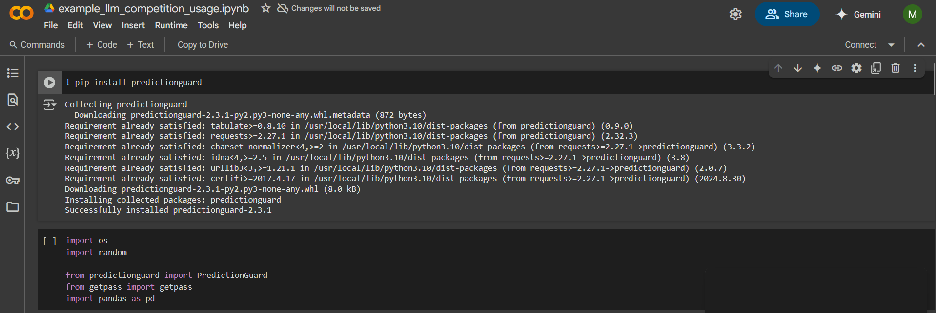
Google Colab
Can use directly with Jupyter notebooks
Easy to collaborate across Google accounts

Slide 3
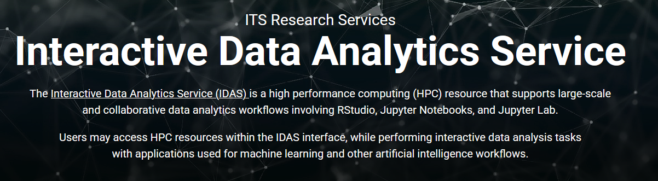
IDAS – Interactive Data Analytics Service
https://idas.uiowa.edu/

Slide 4
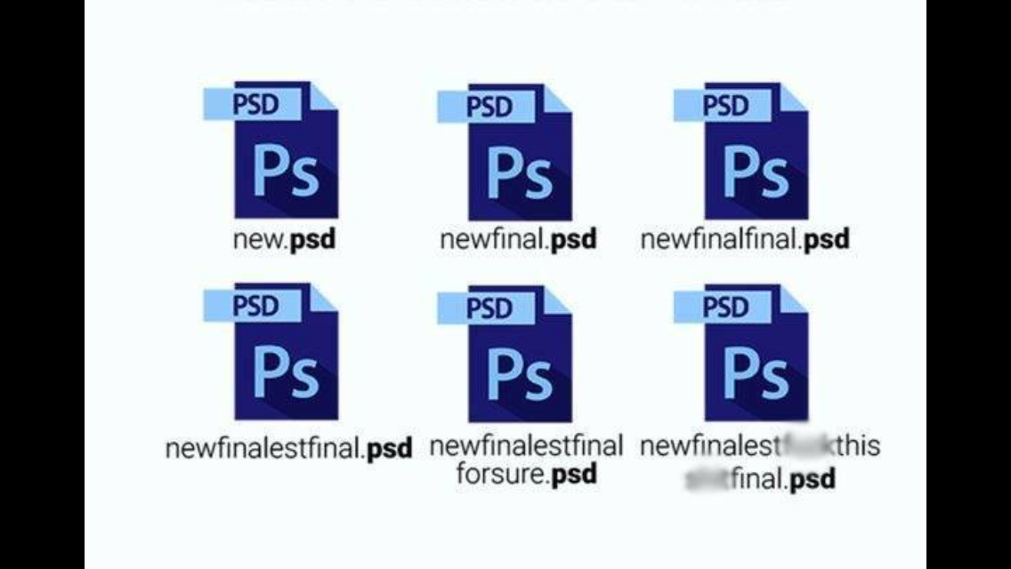
Why do we need version control?

Slide 5
What is version control?
A system that keeps records of your changes.
Entire code and history is stored on your local computer.
Allows you to revert any changes and go back to a previous state.
Allows for collaborative development.
Allows you to know who made what changes and when.
REPOSITORY
REMOTE
REPOSITORY

Slide 6
Git
Documents
on your computer
GitHub
Local version control
Repositories
Project_1
Project_2
.git
local
repository
Folder_1
other_file.ipynb
.git is a hidden folder
file_1.txt

Slide 7
Local version control flow
Track the file
Tracked files & folders and commits are stored in the local .git repository
Edit the file
file status = modified
Stage the file
Commit the file
file status = unmodified

Slide 8
Main branch
commit
commit
commit
commit
commit
commit
Main
time

Slide 9
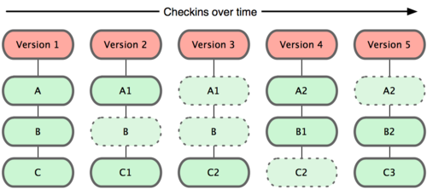
Commit 1
Commit 2
Commit 3
Commit 4
Commit 5
Git commits
Project files
Get stores a snapshot of all your modified files with each commit.
If the file hasn’t changed, it stores a link to the latest version of the file.

Slide 10
Remote repository flow
My computer
GitHub
Push
Project 1
Track the file
Pull
Edit the file
file status = modified
Project 2
Stage the file
Project 3
Commit the file
file status = unmodified

Slide 11
How do I create a repository?
Git & GitHub

Slide 12
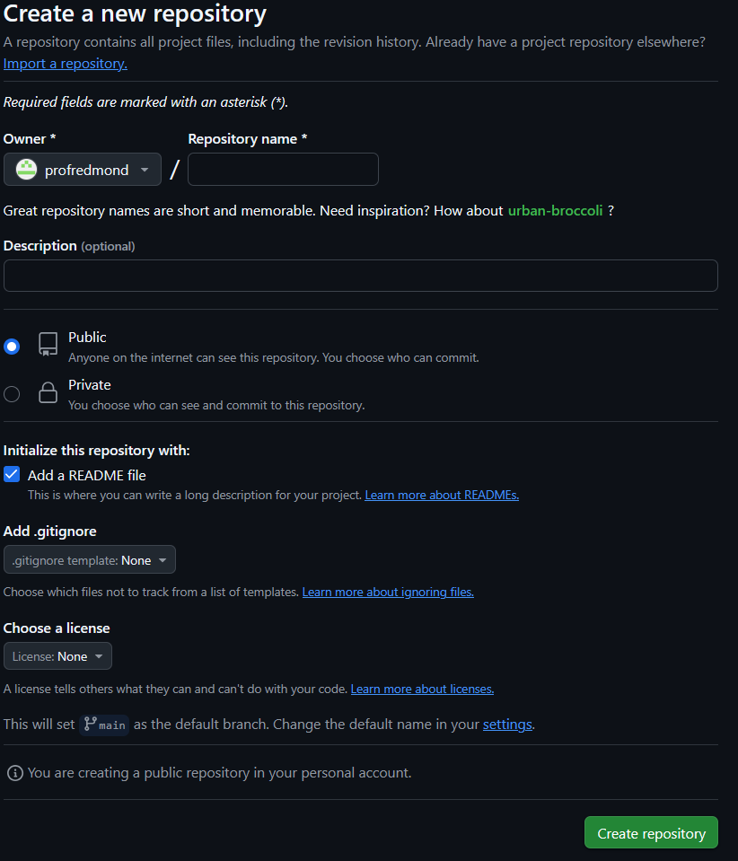
Step 1: Create the repository on GitHub
Creates the repository with two files:
README.md
.gitignore
My GitHub
3250-final-project
Choose public or private
Add a README file
Choose python language
Choose a license if you wish

Slide 13
Step 2: Clone the repository from GitHub
My computer
My GitHub
local repository
3250-final-project
Clone
3250-final-project
This is done the first time you bring the remote repository down to your computer and creates a local repository.
Clone includes all files and folders plus links to the remote repository.
.git
README.md
.gitignore
README.md
.gitignore

Slide 14
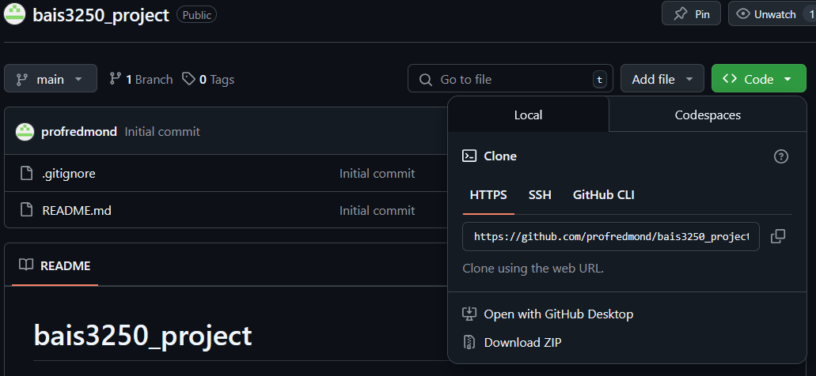
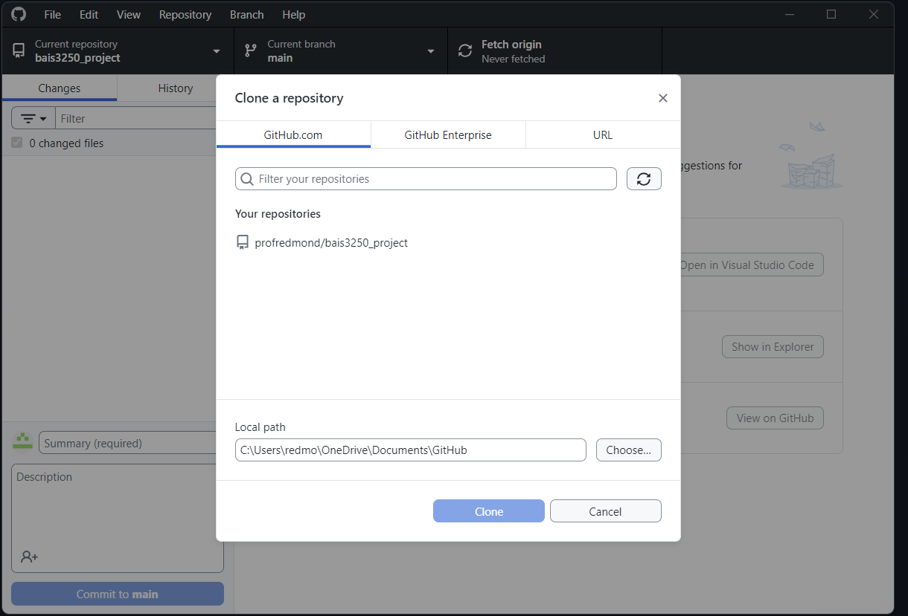
Cloning a remote repository
GitHub Repository
GitHub Desktop

Slide 15
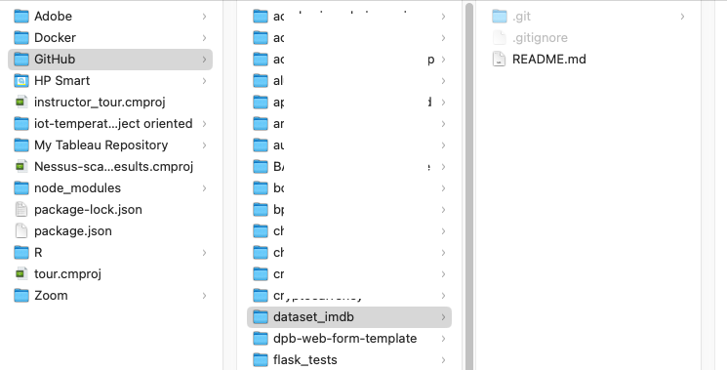
Local repository (project folder)
hidden
on your computer

Slide 16
How do I work on my project?
Git & GitHub

Slide 17
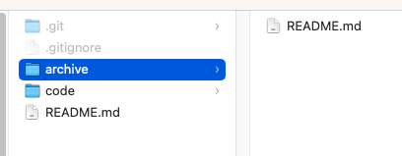
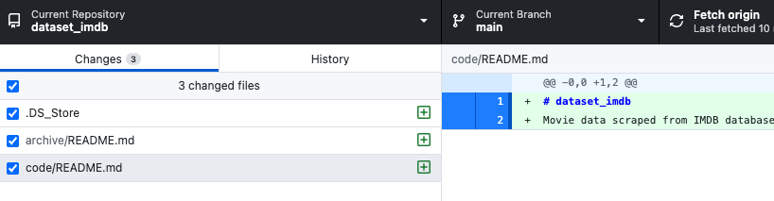
Add new files and folders to local project folder

Slide 18
Step 3: Work on your project
Project folder: 3250-final-project
This might also be called the local repo.
Local
repository
files
Untracked
Tracked
Unmodified
Modified
Staged
Sub-folders
Add files to project folder
Track files
Newly added files
Stage files for commit
commit
Sets file status to unmodified
Untrack files
Repeats as you work on existing files
Edit the files

Slide 19
Project folder on your computer
GitHub Desktop
GitHub
Jupyter Notebook
VSCode
dillinger.io

Slide 20
How do I commit my work?
Git & GitHub

Slide 21
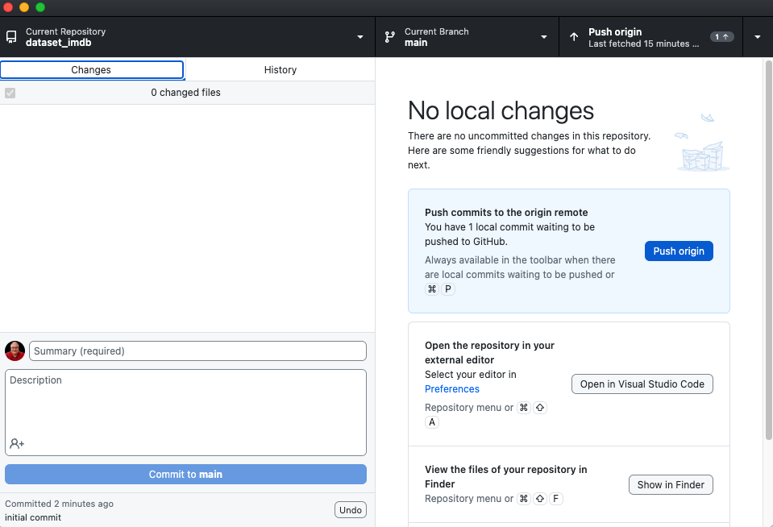
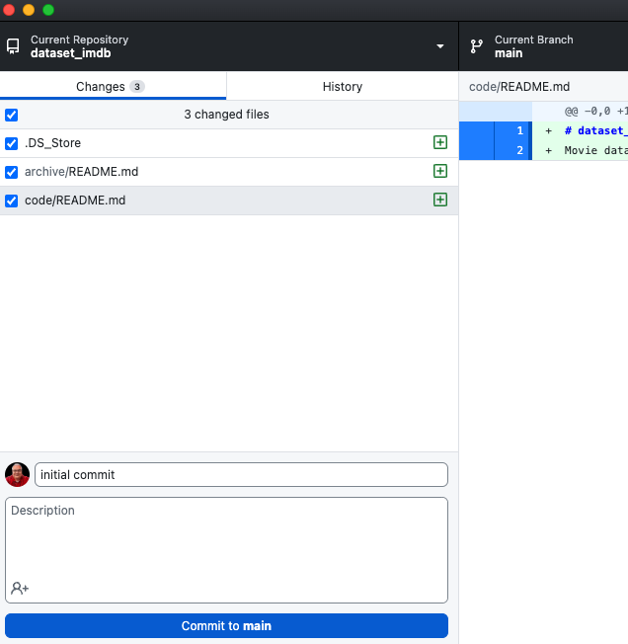
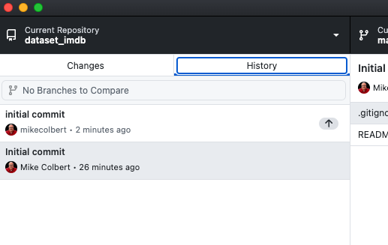
Commits (these are local)
After commit, no changes appear
Files that have changed since last commit
View the history of this repository
Commit message

Slide 22
Step 4: Copy your local repository to your remote repository
My computer
My GitHub
Push
local repository
3250-final-project
Send changes from local repository to the remote repository.
3250-final-project
Pull
README.md
.gitignore
Pull changes from remote repository to the local repository.

Slide 23
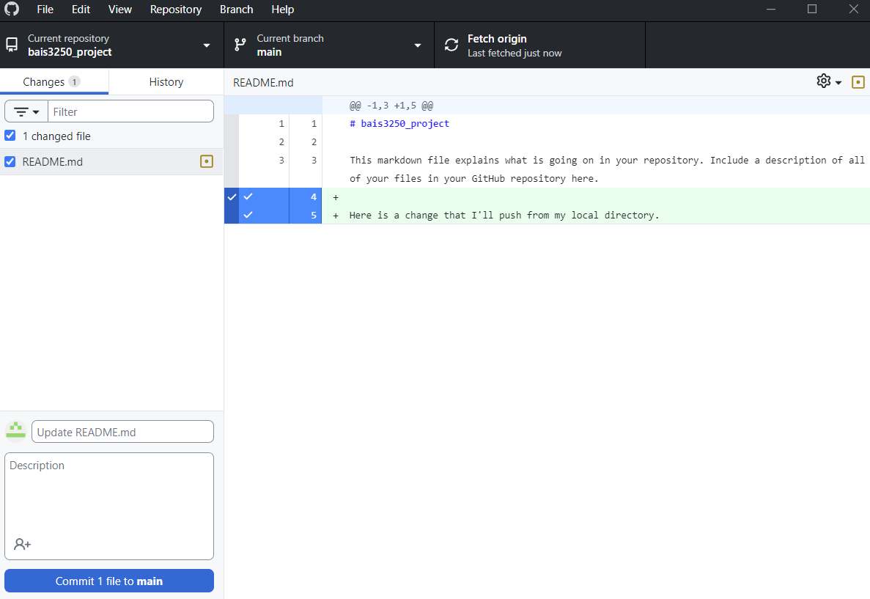
Push

Slide 24
Why should I use topical branches?
Git & GitHub

Slide 25
Main branch
commit
commit
commit
commit
commit
commit
Main
time

Slide 26
Topical branches
commit
commit
commit
commit
Main
branch
merge
commit
commit
commit

Slide 27
How can I ensure code quality?
Git & GitHub

Slide 28
Jupyter Notebook Utilities
nbQA
It acts as a bridge between Jupyter notebooks and the Python code.
It allows you to run code quality tools (like isort, black, and flake8) designed for Python code (.py) in Jupyter Notebooks (.ipynb).
nbstripout
It removes output from Jupyter Notebook files (.ipynb).
Only the essential code and markdown content are committed to version control.
Keeps repositories clean and lightweight.
Avoids unnecessary diffs which make it:
more complicated to track meaningful changes in the code
easier to work in multi-developer environments

Slide 29
Formatting utilities
isort
Utility that automatically sorts and organizes your Python imports according to PEP 8 guidelines.
It groups imports into sections and sorts them alphabetically within each section.
Provides consistent import organization and help prevent merge conflicts due to import order.
Black
A code formatter that automatically formats your code according to a set of predefined rules enforcing a consistent code style.
Produces the most readable and uniform code possible without the need for extensive code reviews or discussions about style.

Slide 30
Linter Utilities
Flake8
A popular Python code linter that checks your code for style and syntax errors.
It has a smaller set of default rules than Pylint, but it is generally faster and more lightweight and focuses on the most common and important code quality issues.
Pylint
It is a more robust code linter that focuses on code quality and best practices rather than just code formatting.
It has a large set of configurable rules and can be customized to fit the specific needs of a project or team.

Slide 31
Security Utilities
Only runs on Python scripts (.py)
Convert notebook to .py and run utility.
Bandit
An open-source security linter used to find common security issues in Python code.
It performs static analysis, which means it inspects the code without executing it, making it a safe and efficient way to identify potential vulnerabilities.
It detects:
Hardcoded sensitive data, such as passwords and API keys.
Use of insecure Python functions (e.g., eval, exec).
It helps prevent security issues early in development by highlighting them before they make it to production.

Slide 32
Code Quality Run Order
nbstripout (removes code cell output)
isort (sorts imports)
Black (formats code)
Flake8 and/or Pylint (linting)
Bandit (security checks)

Slide 33
What needs to be in my repository?
Git & GitHub

Slide 34
Project structure
What are your folders and sub-folders.
Use plain language.
Use clear, precise naming.
DO NOT use spaces.
Prefix files with a number if order is important.
Provide plenty of instructions and context in your README files.

Slide 35
Project README.md
https://medium.datadriveninvestor.com/how-to-write-a-good-readme-for-your-data-science-project-on-github-ebb023d4a50e
https://www.freecodecamp.org/news/how-to-write-a-good-readme-file/
https://github.com/PurpleBooth/a-good-readme-template
https://github.com/KalyanM45/Data-Science-Project-Readme-Template
https://github.com/vanderbilt-data-science/repo-template-2024
https://github.com/ahgroup/data-analysis-template/tree/main
https://github.com/jamessizeland/python-analytics-template
https://github.com/mikecolbert/README-template

Slide 36
What about….?
Data dictionary
What metadata are you including?
Project README?
Data folder README?
Change log
What metadata are you including?
Project README?
Separare CHANGELOG.md?
To Do items
Project README?
Code comments?
GitHub Issues?
Sensitive info
API keys / Logins
.env file
.gitignore file

Slide 37
Jupyter Notebook template
https://github.com/xtreamsrl/jupytemplate/blob/master/jupytemplate/jupytemplate/template.ipynb
https://github.com/jupyter-naas/awesome-notebooks/blob/master/Advertools/Advertools_Analyze_website_content_using_XML_sitemap.ipynb
https://gist.github.com/Jufcferrari/ebd6dd8ebb6b3257a169efb4b629d988
https://github.com/SUKHMAN-SINGH-1612/Data-Science-Projects/blob/main/Crop%20Yield%20Prediction/crop%20yield%20prediction.ipynb

Slide 38
How do I work on a team?
Git & GitHub

Slide 39
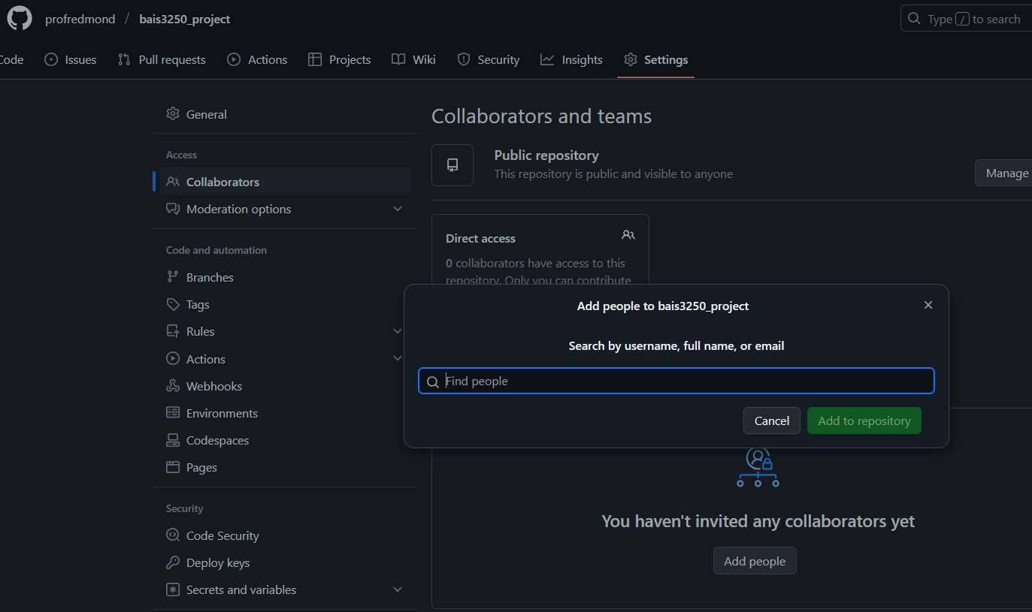
Adding collaborators
GitHub → Settings (repository top menu) → Collaborators
GitHub account of collaborator

Slide 40
1. clone
1. clone
GitHub
3250-final-project
3. pull
2. push
local commits
local commits
5. pull
4. push
work
work
Always start your work session with a pull to get the latest changes from the remote repository.
Always end your work session with a push so the latest updates are on the remote repository.
My computer
My partner’s computer
local repository
local repository
3250-final-project
3250-final-project

Slide 41
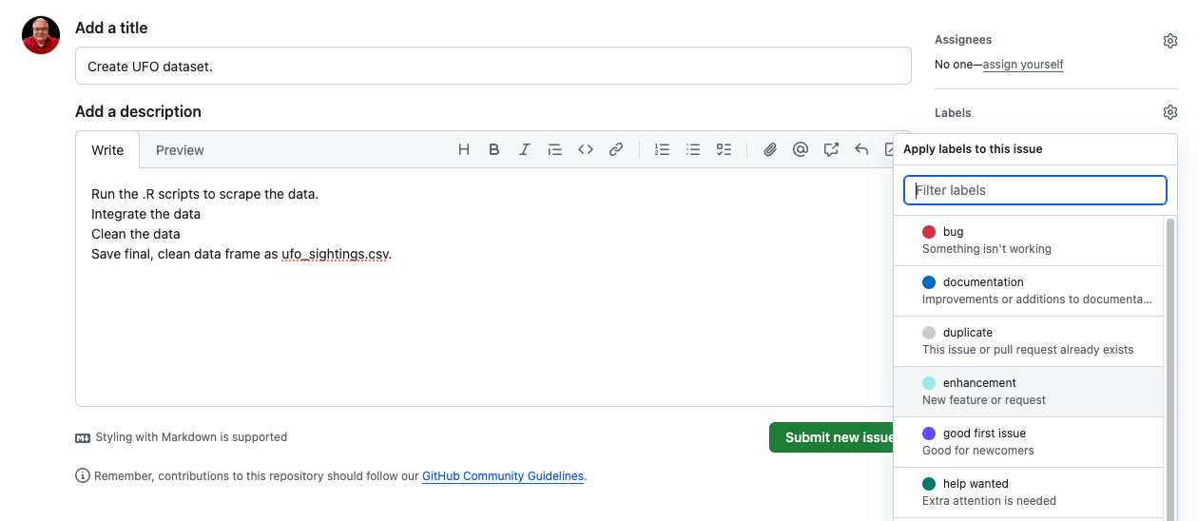
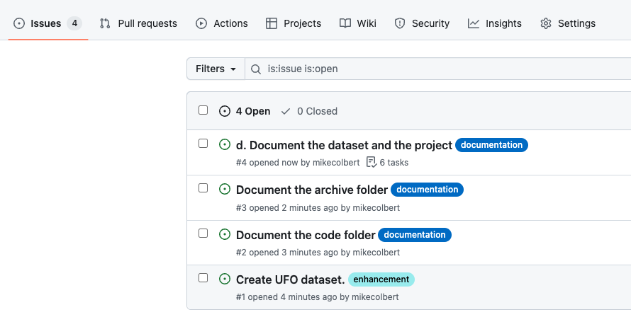
Creating new issues
GitHub repository → Issues (top menu) → New issue

Slide 42
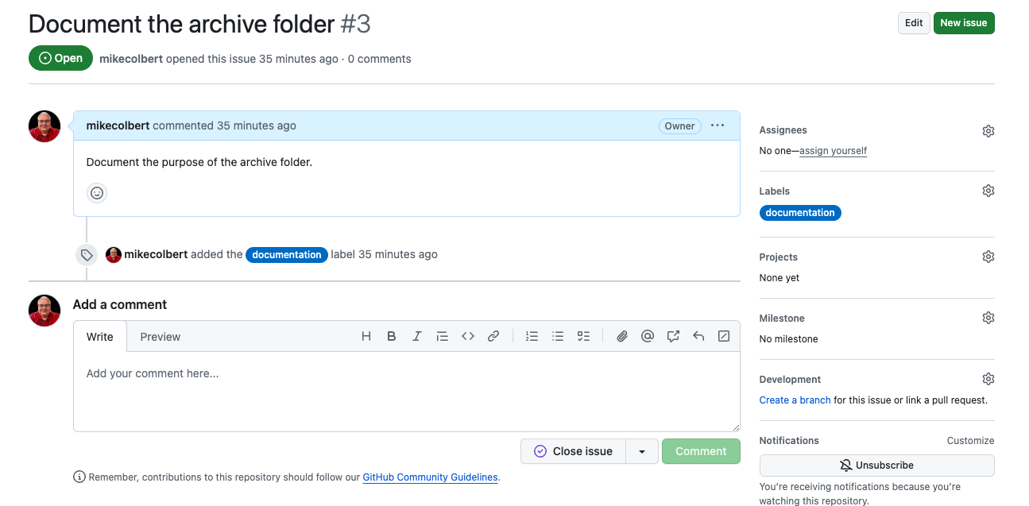
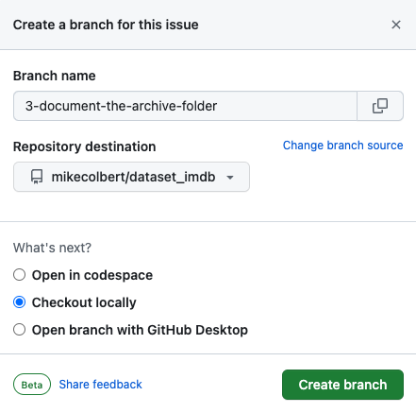
Resolving issues – assign yourself an issue

Slide 43
Why should I use branches on a team?
Git & GitHub

Slide 44
Main branch
commit
commit
commit
commit
commit
commit
Main
time

Slide 45
Topical branches
commit
commit
commit
commit
commit
commit
Main
commit
commit
commit

Slide 46
Topical branches
commit
commit
commit
commit
commit
commit
Main
Both made a copy of Main. There were no changes between the time green branched and orange branched. They have the same Main code.
commit
commit
merge conflict
commit

Slide 47
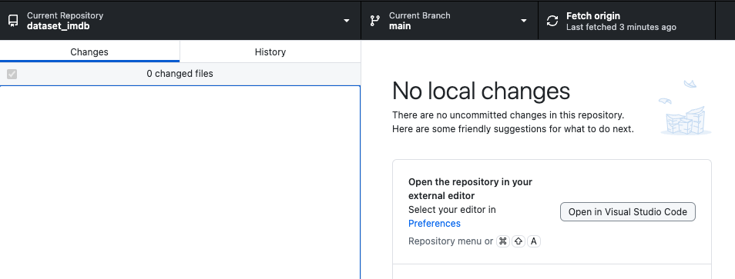
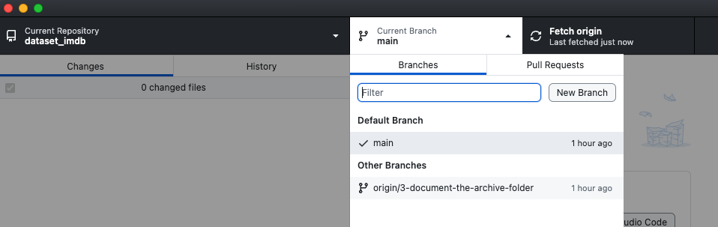
Resolving issues – change to your issue branch
Fetch origin to get the latest changes to the repository.
Select the new branch

Slide 48
Resolving issues – do the work
Do the work necessary to resolve the issue.
You can still commit. Just make sure you are on your issue branch.
You can push your issue branch to GitHub if you want.

Slide 49
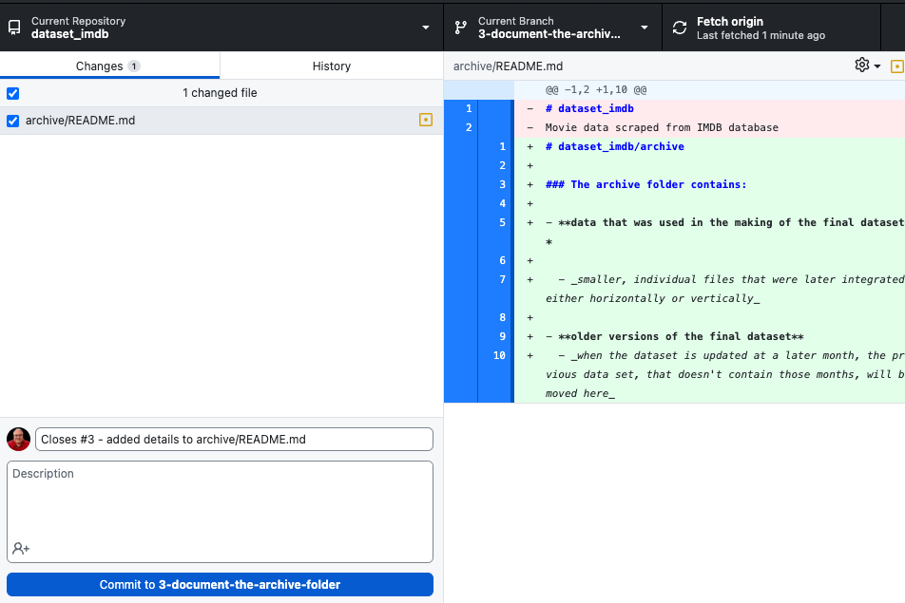

Resolving issues – finishing up the work
Be sure you are on the issue branch.
From GitHub Issues
I’m working on Issue #3 for this repository
When the issue is resolved, I’ll use the keywork Closes # followed by the issue number and then my commit message.
After committing, Push to origin

Slide 50
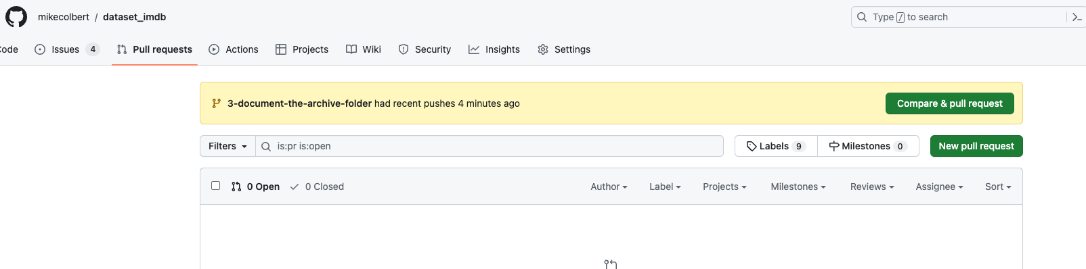
Resolving issues – pull request
After you commit and Push to origin, you can see your commit.
Click Compare & Pull Request

Slide 51
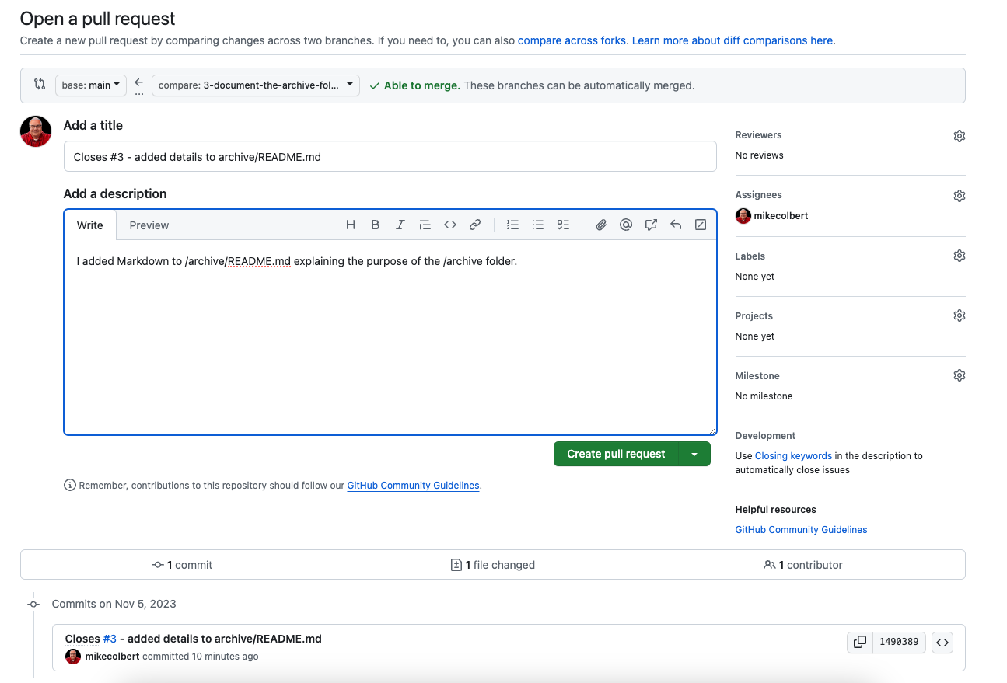
Resolving issues – creating a new pull request
Assign the pull request to yourself or the repository owner.
Add a description of what you did.
Create the pull request.

Slide 52
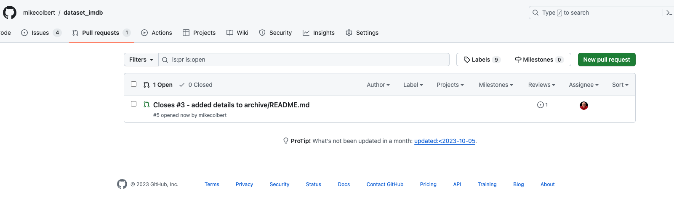
Resolving issues – viewing pull requests
View pull requests where the author feels they are ready to become part of the code base.

Slide 53
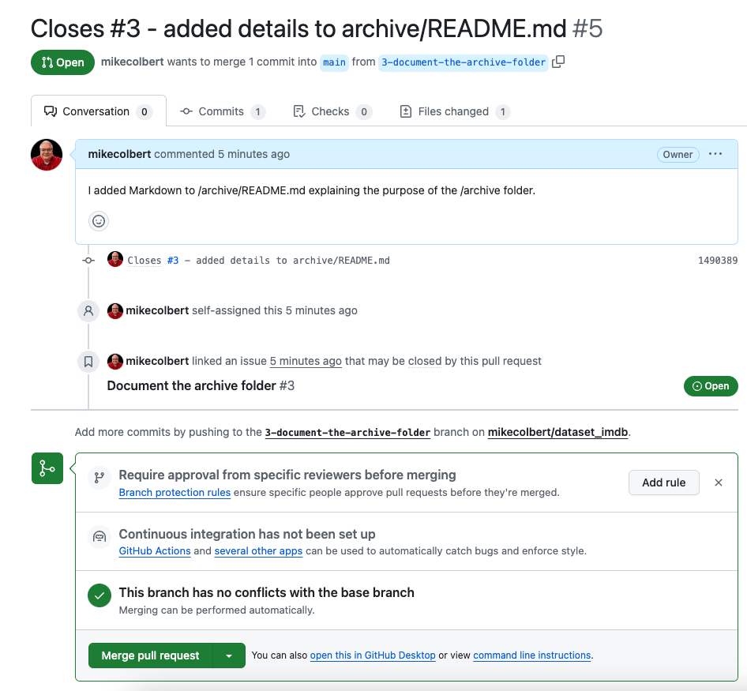
Resolving issue – accept the pull request
Confirm merge
Delete branch

Slide 54
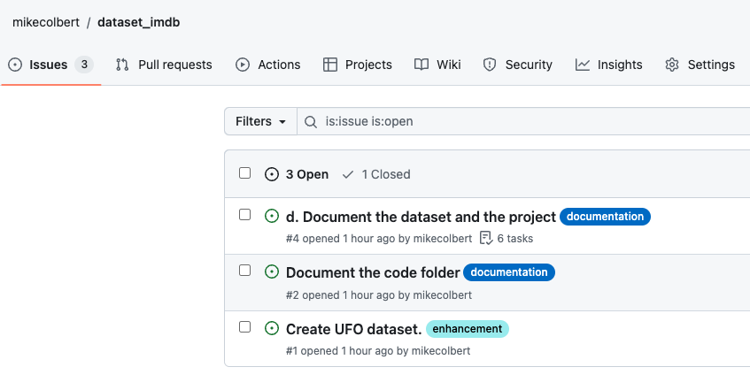
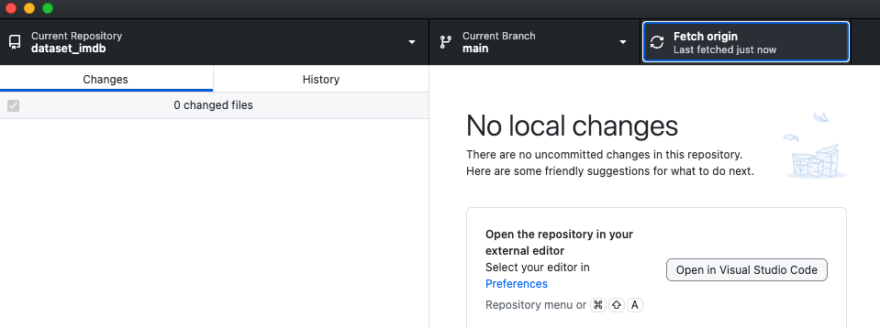
Resolving issues – finishing up
Issue is closed.
Switch back to main branch.
Issue is closed.

